Slide 1
Music notebook
Java project

Slide 2
Goals of the project
Database
Web-app
Rest-app
Should be built in 2 jar files:
Web-app provides UI
Rest-app provides API for database access
Root framework is Spring

Slide 3
Project theme
Music Notebook is an application for recording descriptions of your favorite songs and making playlists from them.
Music notebook must provide:
CRUD for songs
CRUD for playlists
Sort songs by playlists
Filter songs by release date

Slide 4
Database structure
playlists
playlist_Id
Title
playlists_songs
playlist_id
song_id
songs
song_id
singer
title
album
release_date
Many-to-many relationship

Slide 5
Project structure
Web-app
Rest-app
service-rest
service-dao
dao-jdbc
service-api
dao-api
model
test-db

Slide 6
Rest-app description
Technologies:
Spring Boot
Spring Jdbc
Spring MVC
Spring Test
Jupiter
Mockito
MockMVC
Logback
Jackson
H2
MySQL
PostgreSQL
Swagger2 UI
Hibernate validator
Apache Maven
Features:
Independent testing of each layer
Handling exceptions with a controller advice
By default, the Н2 in memory database is used, but it is possible to launch the application with profiles for mysql or postgres databases

Slide 7
Web-app description
Technologies:
Spring Boot
Spring MVC
Spring Test
Bootstrap
Thymeleaf
Logback
Jupiter
Jackson
MockMVC
Apache Maven
Features:
Adaptive design
Handling exceptions with a controller advice
Integration tests covering all layers at once

Slide 8
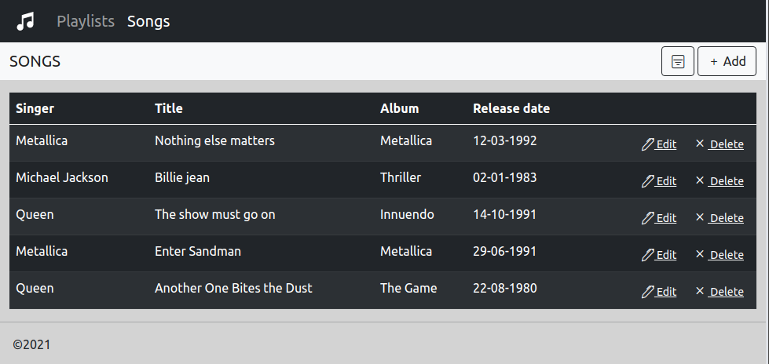
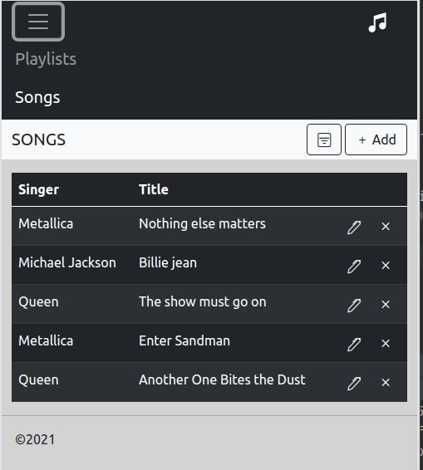
Adaptive design

Slide 9
Building and running the application
Building tool is Apache Maven
The Maven builds two executable jar files. When you run these files, the application is automatically deployed to the embedded Tomcat server.
Can be run separately as standalone applications with docker
Can be run as a single application with docker-compose (with mySQL database)

